Slide 1


USER ANALYTICS
Shreya Gunjal

Slide 2
Project Overview
The aim of this project is to provide insights into our consumer metrics, their preferences as well as other valuable information to drive marketing strategies and investment decisions.
We have conducted analysis based on available data to reach certain conclusions about
user engagement, popular trends, frequency of their activities, authenticity of user accounts
We have also targeted our analysis towards fulfilling requests from our marketing and investment teams to achieve better engagement from certain users, rewarding our most dedicated users, as well as avoiding infestation of bot accounts.
Finally, in consideration of our resources, we have figured out the best times to launch marketing strategies to reach out to people.

Slide 3













Approach
Loyal User Reward
The main objectives of the project are mentioned on the left bar.
Note that the dataset provided had information about app users, photos, likes, photo tags, tags, comments and follows.
Based on this data the easiest and least time consuming process was used, by using SQL workbench as the information was more readable using tables. It also made it easier to compare different tables, join them or use aggregation functions.
View tables have also been created in some cases to use for ease for certain queries, to be used for other queries later.
The findings to each of the queries are answered in the following slides along with code used to arrive to the conclusion.
Inactive User Engagement
Contest Winner Declaration
Hashtag Research
Ad Campaign Launch
User Engagement
Bots & Fake Accounts

Slide 4

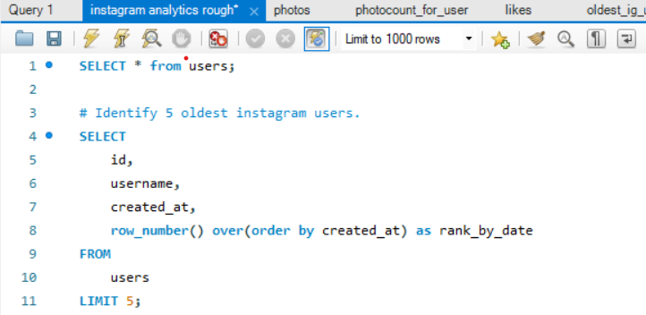
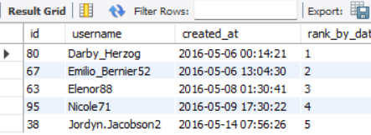
Loyal User Reward
Following was the query used to calculate 5 most loyal users of Instagram. The dataset was searched for accounts that have the earliest account creation date. These accounts were then matched with their usernames with common ids. Here are the five oldest Instagram users:

Slide 5

5 Oldest Users for Loyalty Reward
1st
Darby_Herzog
06-05-2016
2nd
Emilio_Bernier52
06-05-2016
3rd
Elenor88
08-05-2016
4th
Nicole71
09-05-2016
5th
Jordyn.Jacobson2
14-05-2016

Slide 6
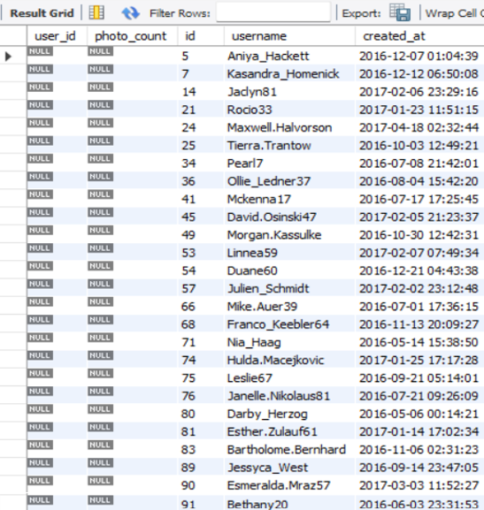
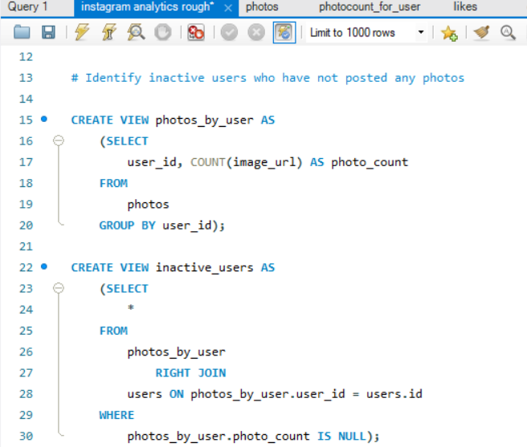
Interactive User Engagement
The team wanted to target inactive users to start posting by sending them promotional emails. Using the data available on photos posted and the users associated to them, we were able to rule out the users who have never posted on Instagram.

Slide 7

List of Inactive Users
USER IDs | USERNAMES
5 | Aniya_Hackett
7 | Kasandra_Homenick
14 | Jaclyn81
21 | Rocio33
24 | Maxwell.Halvorson
25 | Tierra.Trantow
34 | Pearl7
36 | Ollie_Ledner37
41 | Mckenna17
45 | David.Osinski47
49 | Morgan.Kassulke
53 | Linnea59
54 | Duane60
57 | Julien_Schmidt
66 | Mike.Auer39
68 | Franco_Keebler64
71 | Nia_Haag
74 | Hulda.Macejkovic
75 | Leslie67
76 | Janelle.Nikolaus81
80 | Darby_Herzog
81 | Esther.Zulauf61
83 | Bartholome.Bernhard
89 | Jessyca_West
90 | Esmeralda.Mraz57
91 | Bethany20

Slide 8
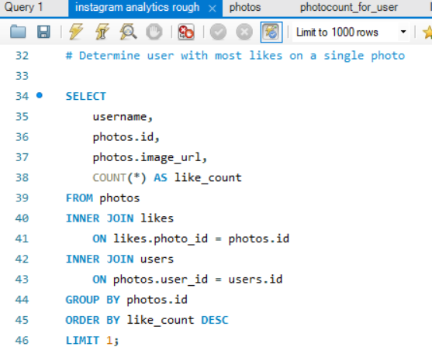
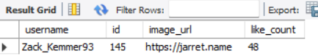
Contest Winner Declaration
The team wanted to reward the user for most likes on a single photo to increase activity on the app. For this, we used dataset on likes and photo ids to match them with the user who posted the photo. Here are the details:

Slide 9













Contest Winner
48
Zack_Kemmer93
Zack_Kemmer93
A well-deserved victory! 🔥🙌 #mostlikedwinner
5:00 AM
Message...

Slide 10
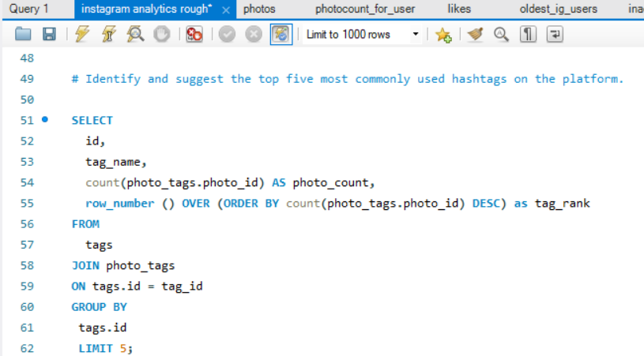
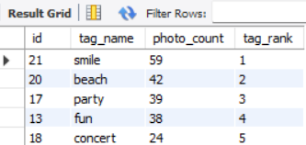
Hashtag Research
In order to get brand deals, the company needs insight on popular hashtags to better market a brand using the algorithm. For this, we used dataset on tags on photos and tag details to find the five most popular tags used:

Slide 11




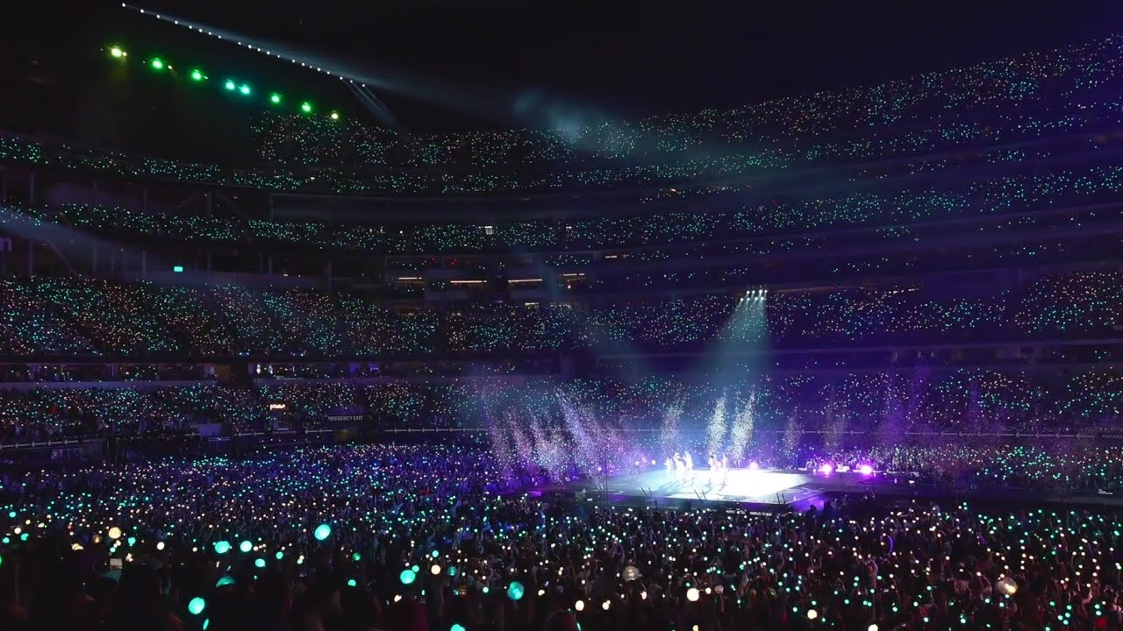

Popular Hashtags
Follow
Message
#smile
#beach
#party
#fun
#concert

Slide 12
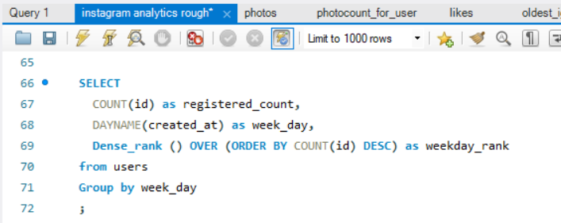
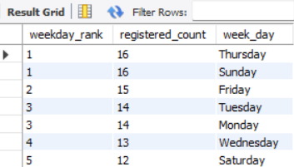
Ad Campaign Launch
The data on account creation dates gives an insight on what weekdays users are most engaged on the platform. This data can be used to better target ad campaigns towards active or non-active users:

Slide 13


Days with most accounts:

Slide 14
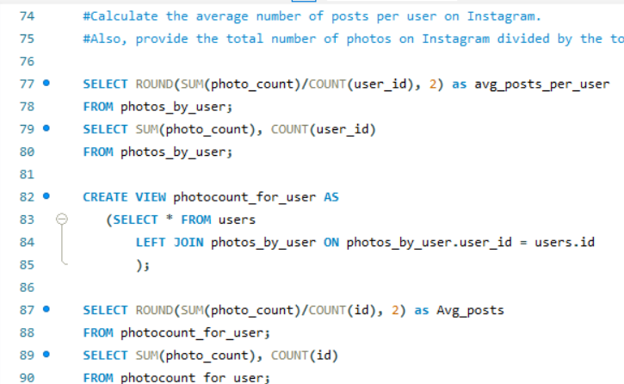
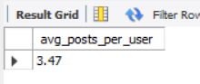
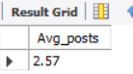
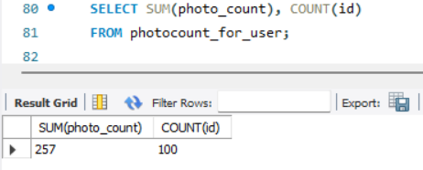
User Engagement
The following data on posts made per users gives an idea about user engagement on the platform. For reference, total no. of users as well as posts are also given:

Slide 15


User Engagement
257posts/ 74 active users
=
3.47 posts per active user
257posts/ 100 active users
=
2.57 posts per user

Slide 16
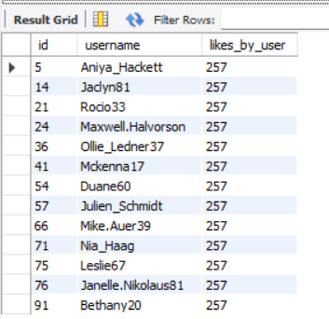
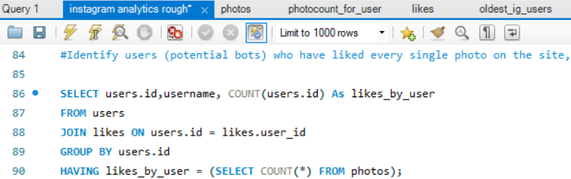
Bots and Fake Accounts
In order to make the platform more authentic and engage users, bots and fake accounts have been detected using dataset on likes and usernames and ids associated with those accounts. These users have liked every single photo available on the platform:

Slide 17

Bots and
Fake Accounts
ID | USERNAME
5 | Aniya_Hackett
14 | Jaclyn81
21 | Rocio33
24 | Maxwell.Halvorson
36 | Ollie_Ledner37
41 | Mckenna17
54 | Duane60
57 | Julien_Schmidt
66 | Mike.Auer39
71 | Nia_Haag
75 | Leslie67
76 | Janelle.Nikolaus81
91 | Bethany20
Beep-beep boop! #reportbots
Nia_Haag
5:00 AM
13 users are suspected to be bots...

Slide 18



Tech Stack Used:
MySQL Workbench
8.0
The tech stack was used due to it being crucial for table calculations and dealing with big datasets with ease as it is easy to use and less tie-consuming.
The application also allows to use complicated operations like joining tables with common factors, aggregations, grouping by and order the results to improve readability of your results.

Slide 19
Insights and Results
This project helped me realize that all data is important. Something as simple as the data on likes can be used to arrive to significant conclusions such as identifying bots/ fake accounts.
Another insight is how the user engagement affects brand deals for every company. Popular trends and hashtags can be used to market products and gain confidence of other companies and this can be used to negotiate collaborations to push our own business further.
While we realize that ad campaigns are important for every company, its important that we save resources all the while be more efficient by targeting campaigns on days when people are more likely to respond to them. Such an approach is better than targeting everyone at all times.
Representation of data is definitely as important as running queries and getting results. We have to present the data in a report rather than simply answering questions.
It is no surprise that all companies require data analysts for their businesses to push marketing teams, investment and finance teams and other teams to make better decisions using analysis provided by data analysts.

